Slide 1
NADA on Campus: Pilot group 2017-2018 East Lansing, MI
Presented by:
Sara Marino, LMSW, LLMFT, ADS, SHCP-Michigan Trained
Trauma/Sex Therapist

Slide 2
Setting
Michigan State University’s Sexual Assault Program on campus
Served student survivors of sexual assault
Provided therapy and advocacy

Slide 3
Ear Acupuncture Group
Summer 2017-Spring 2018
Weekly daytime drop-in
1-8 students
On-Site
Free
Open to all genders
1 ADS & 1 co-facilitator

Slide 4
Benefits for Sexual Assault Survivors
SUD treatment and prevention
Relaxes nervous system
Emotional release
Non-Verbal
Accessible
Multi-cultural
Natural & Safe
Supplements other program services

Slide 5
Outcomes

Slide 6
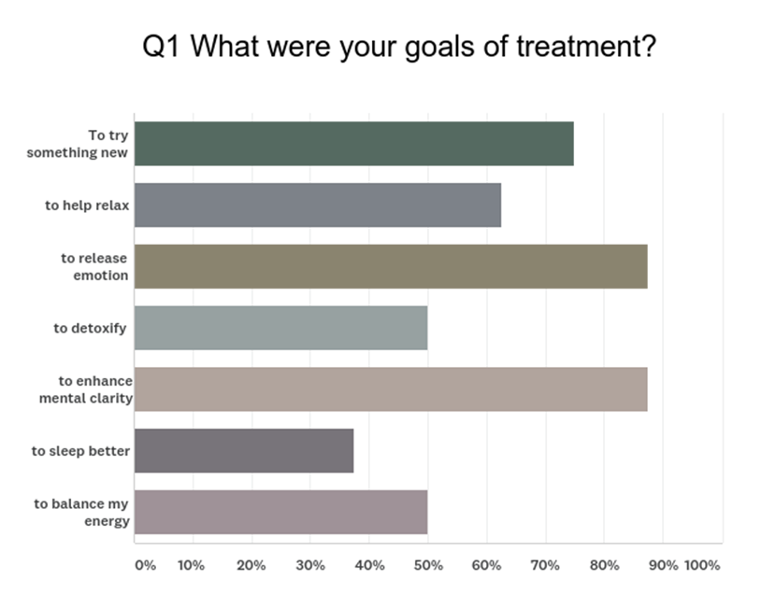
Participant Goals

Slide 7
Goal Achievement

Slide 8
Self-reports
The session gives me time to just relax and do nothing.
I noticed I am less likely to be dissociative or numb out in my day to day life.
Authenticity and sharing experiences.
It has definitely helped me with emotions management and processing.
I was doing something to help myself heal.
Seeing other students showing up makes me happy to see them valuing self-care and self-love.
This is something I have wanted to try and this was the first time a group felt safe and welcoming.
How relaxed I felt after the session.

Slide 9
Thank you!
Please feel free to contact me at:
sara@eternwayscounseling.com

