Slide 1
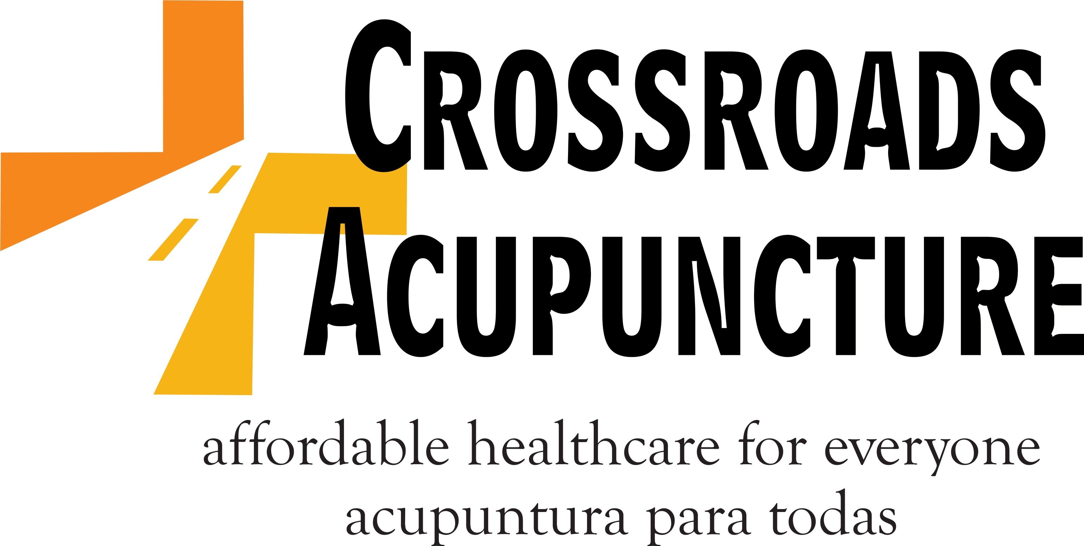
NADA Services as a Humanitarian Aid Model for Refugee Care in the Borderlands CROSSROADS COMMUNITY SUPPORTED HEALTHCARE, Las Cruces, NM Promotores Descalzos (Barefoot Health Promoters) Community acupuncture and NADA school, Catholic Diocese of Juarez, MX CROSSROADSACUPUNCTURE.COM CONTACT: CROSSROADSACU@GMAIL.COM

Slide 2
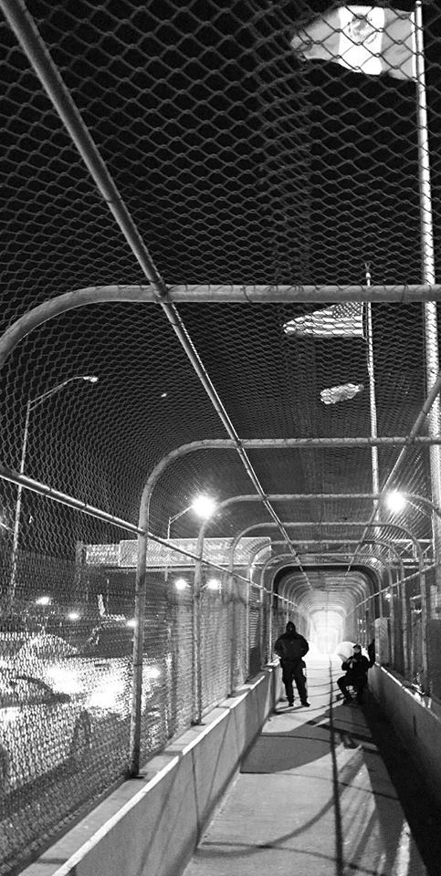
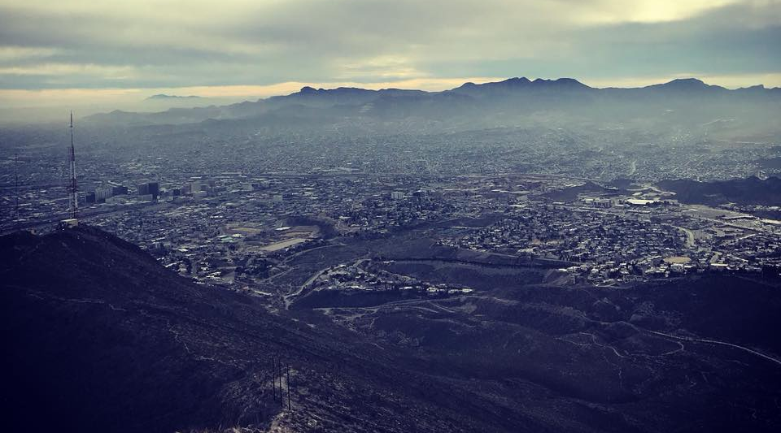
The US Mexico Border: El paso, TX Las Cruces, NM Ciudad Juarez Mexico

Slide 3
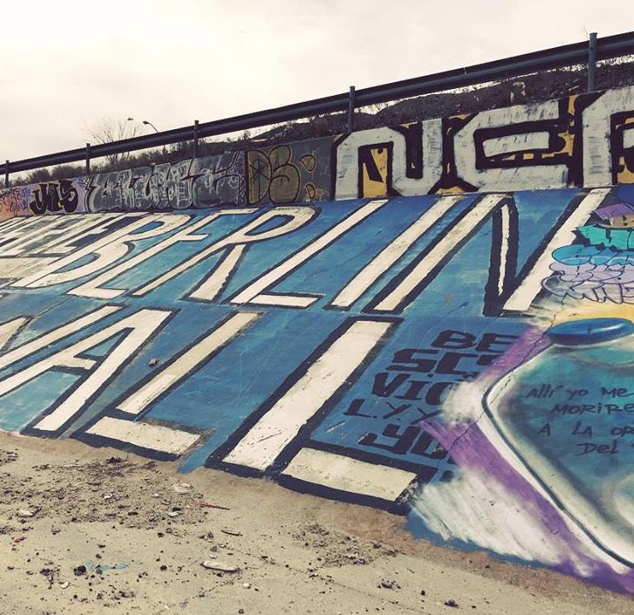
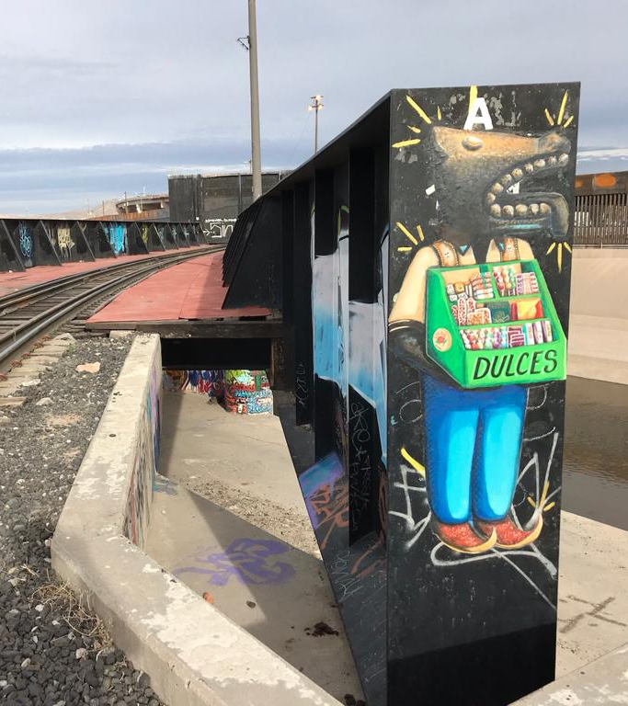
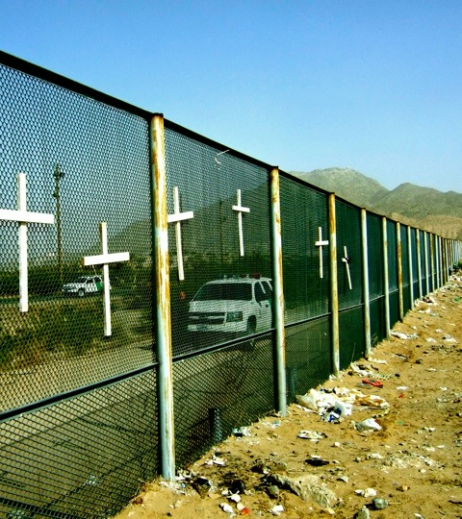
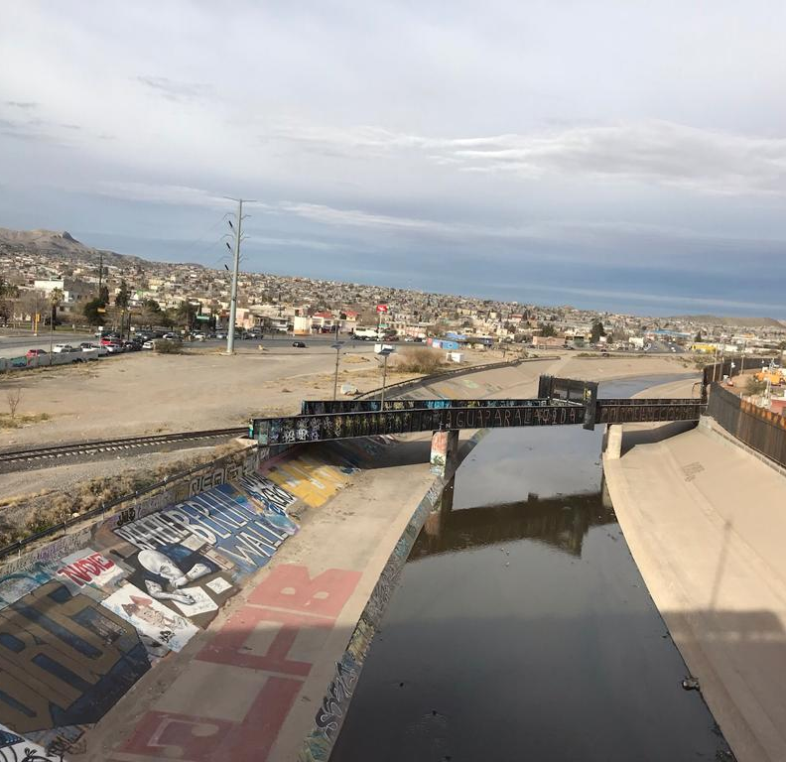
THE WALL

Slide 4
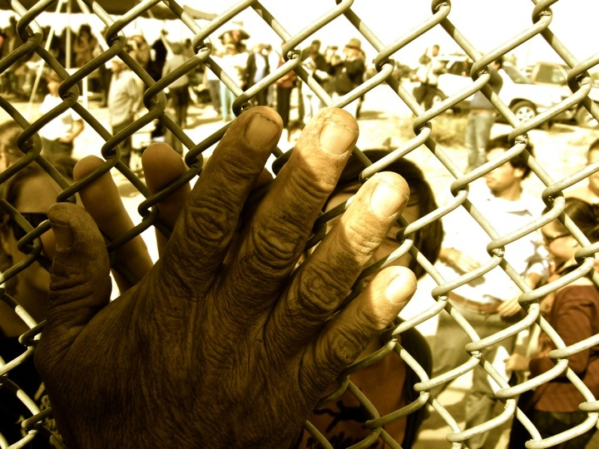
A sign of peace through the border fence at a mass for peace, Day of the Dead, 2011

Slide 5
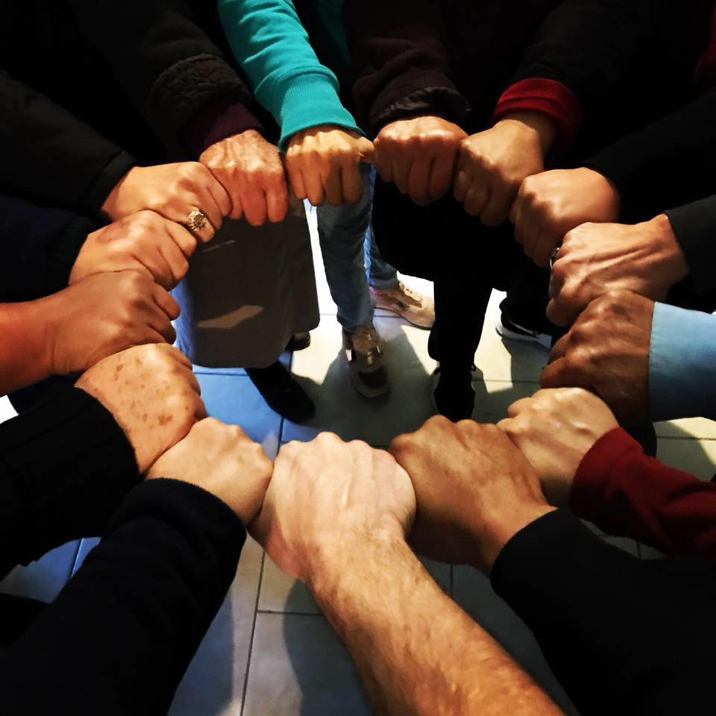
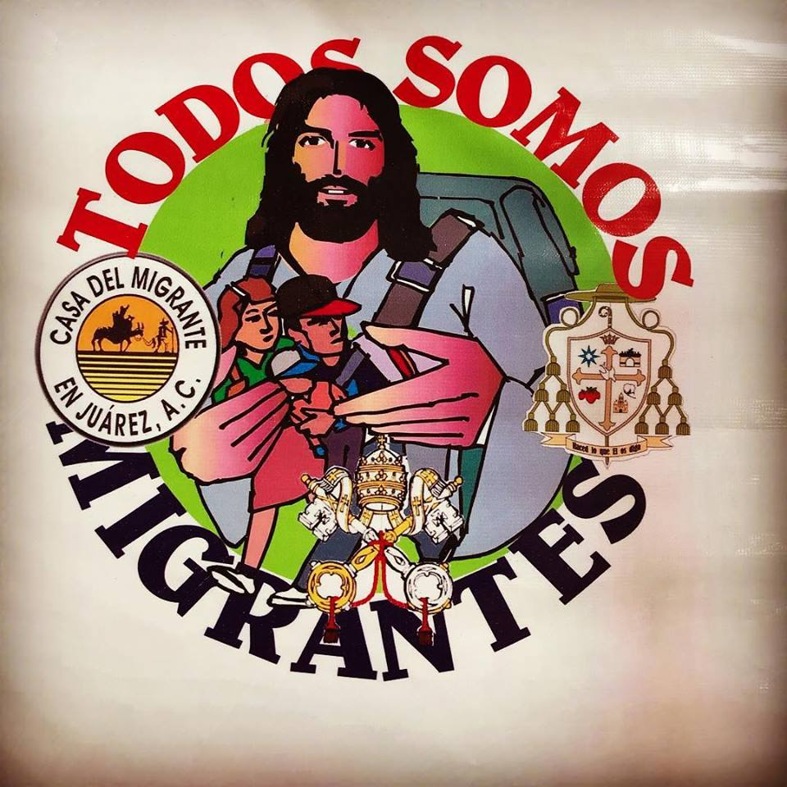
Solidarity with migrants and Refugees “we are all migrants”

Slide 6
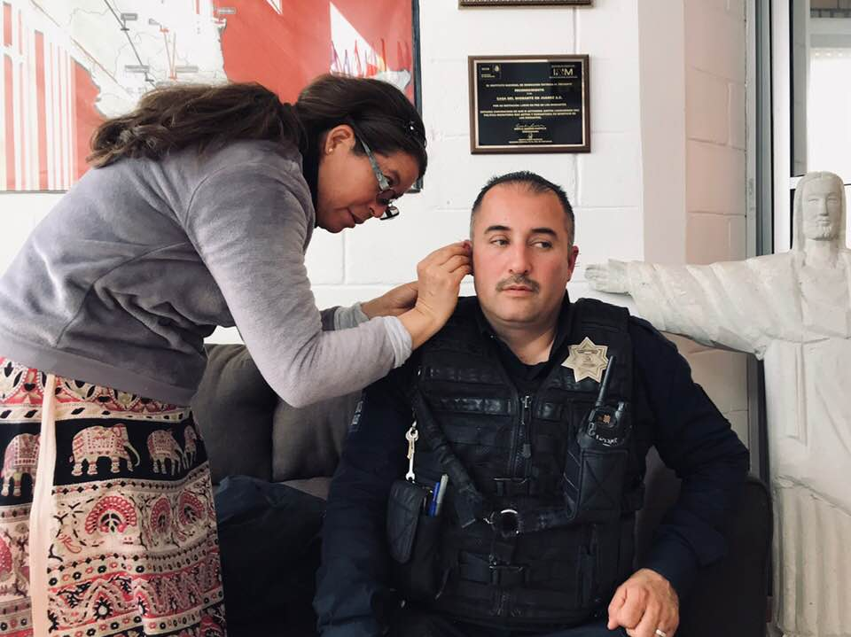
The nun, the migrant security guard, and the hand of jesus

Slide 7
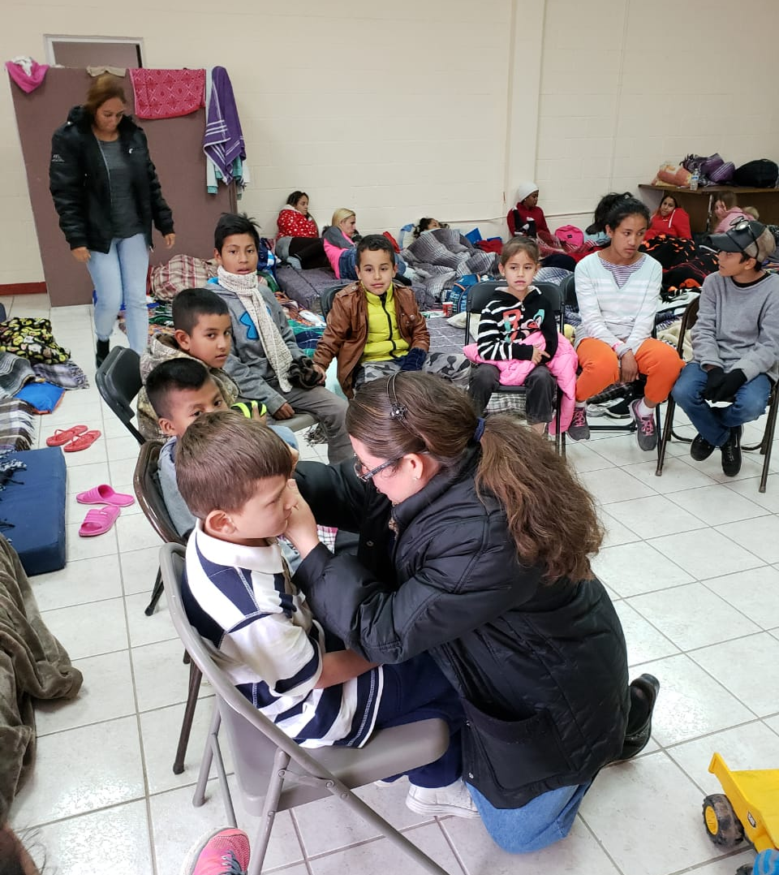
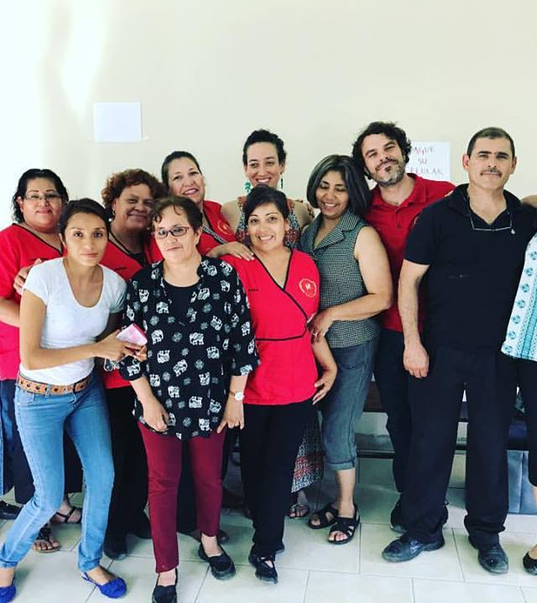
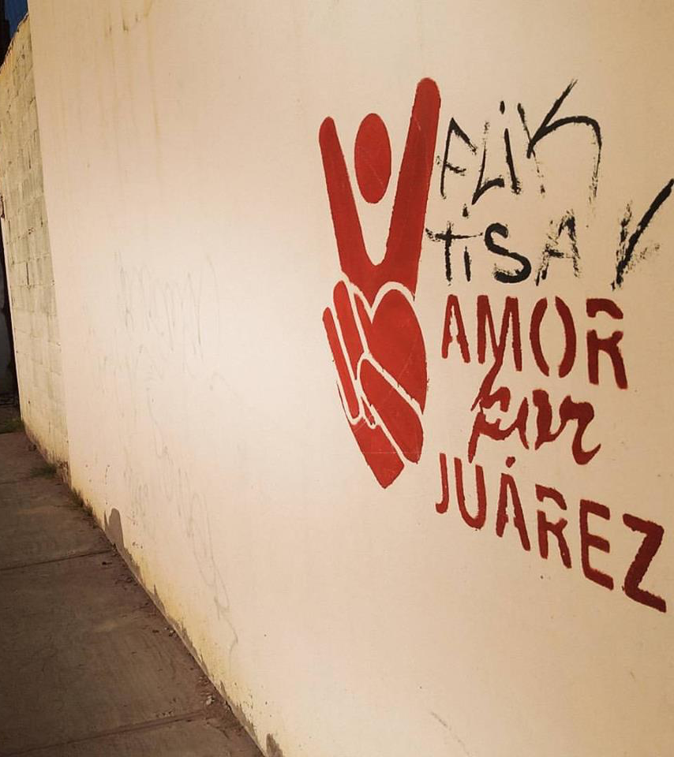
Promotores Descalzos (Barefoot Health Promoters) NADA training program in Juarez Offering free education for providers working with refugees and migrants sponsored by the catholic diocese of juarez, mexico

Slide 8
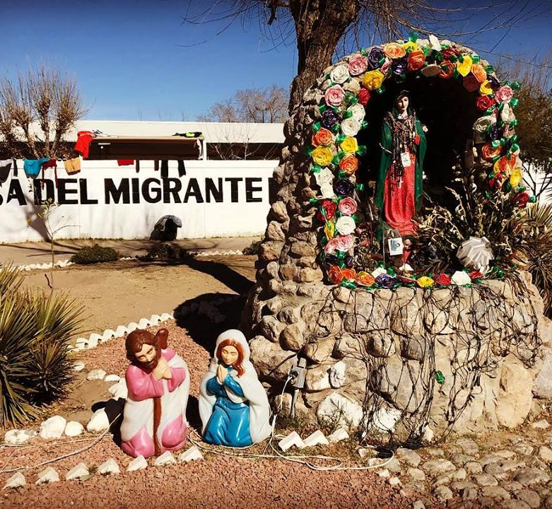
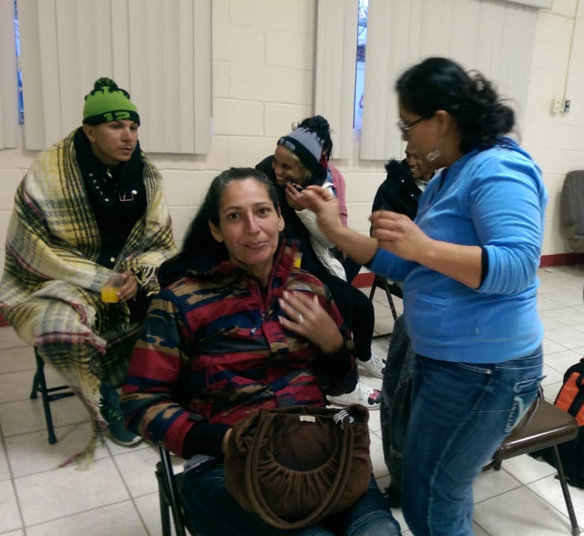
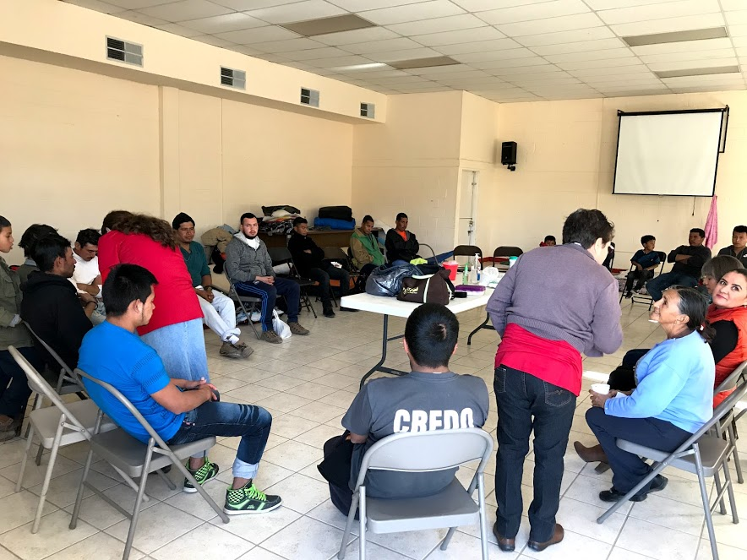
CASA MIGRANTE Weekly nada groups Up to 600 refugees sheltered any given week From Africa and Latin America Fleeing violence, war and poverty Migrants await their asylum case to be heard

Slide 9
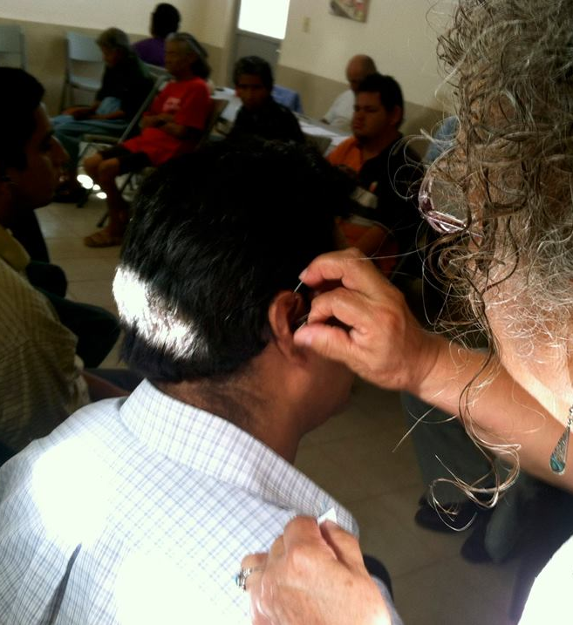
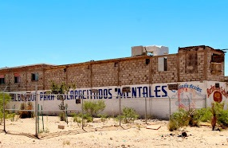
Vision en Accion NADA offered for deportees and refugees at shelter on the outskirts of Juarez 30 km south of the us border

Slide 10
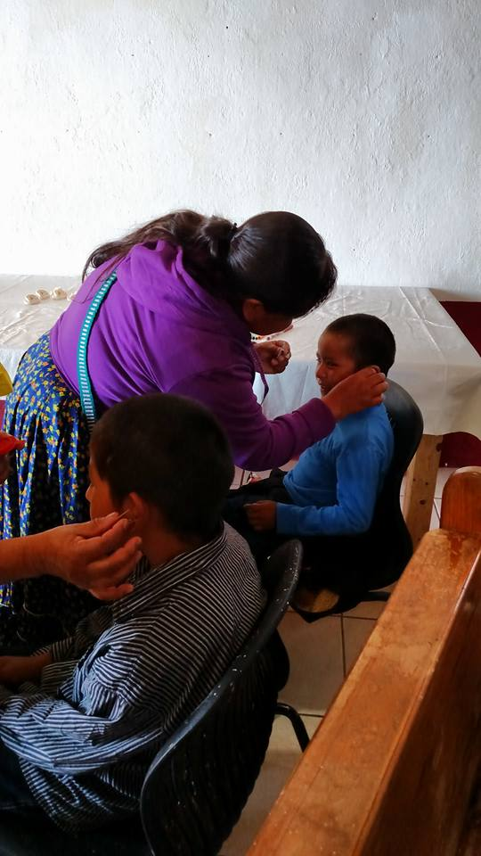
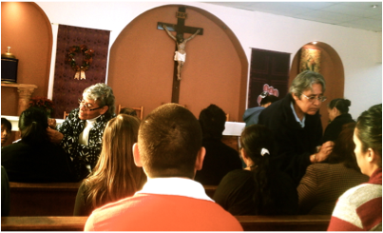
Churches offering sanctuary nada offered for everyone

Slide 11
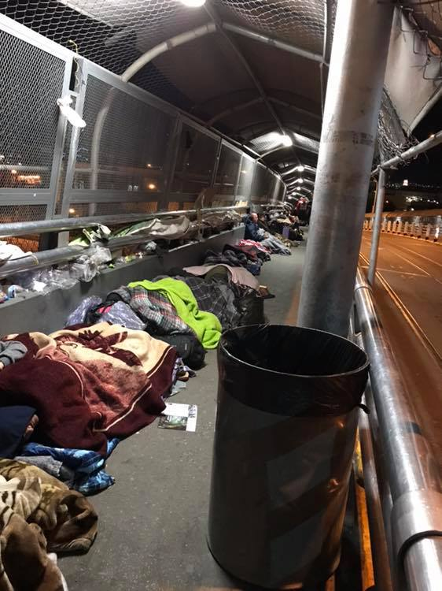
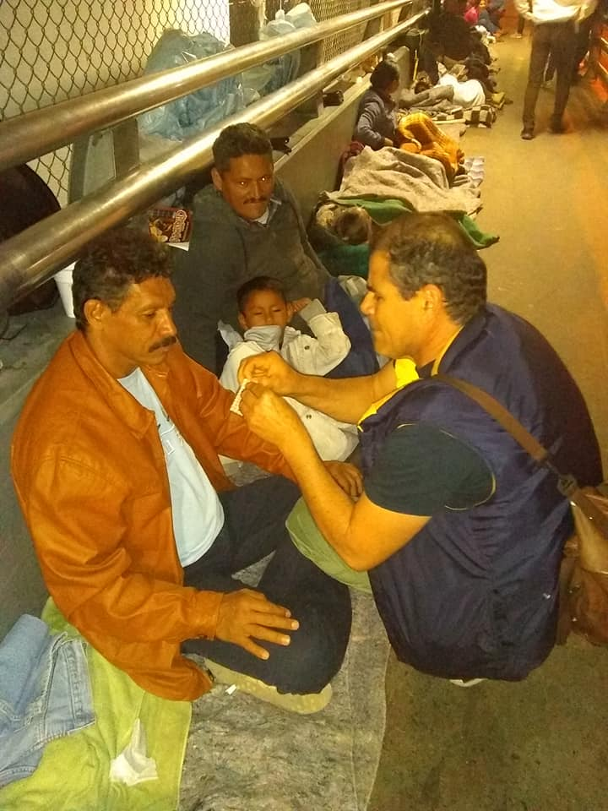
nada Outreach for homeless refugees migrant caravan camped out at the rio grande bridge / border crossing

Slide 12
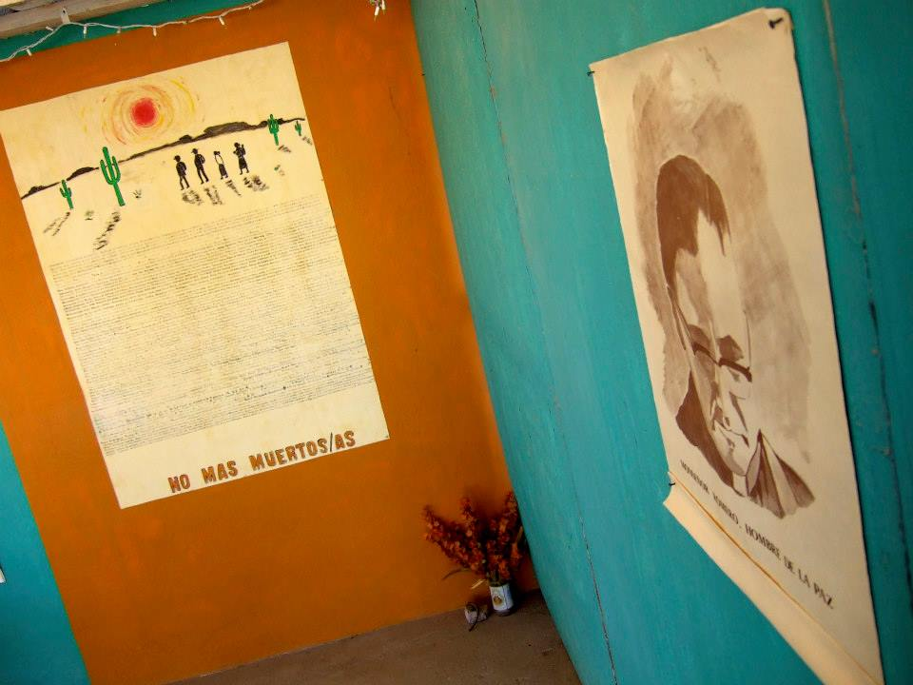
Remembering the dead: Names of Migrants who died crossing the desert to reach the US.

Slide 13
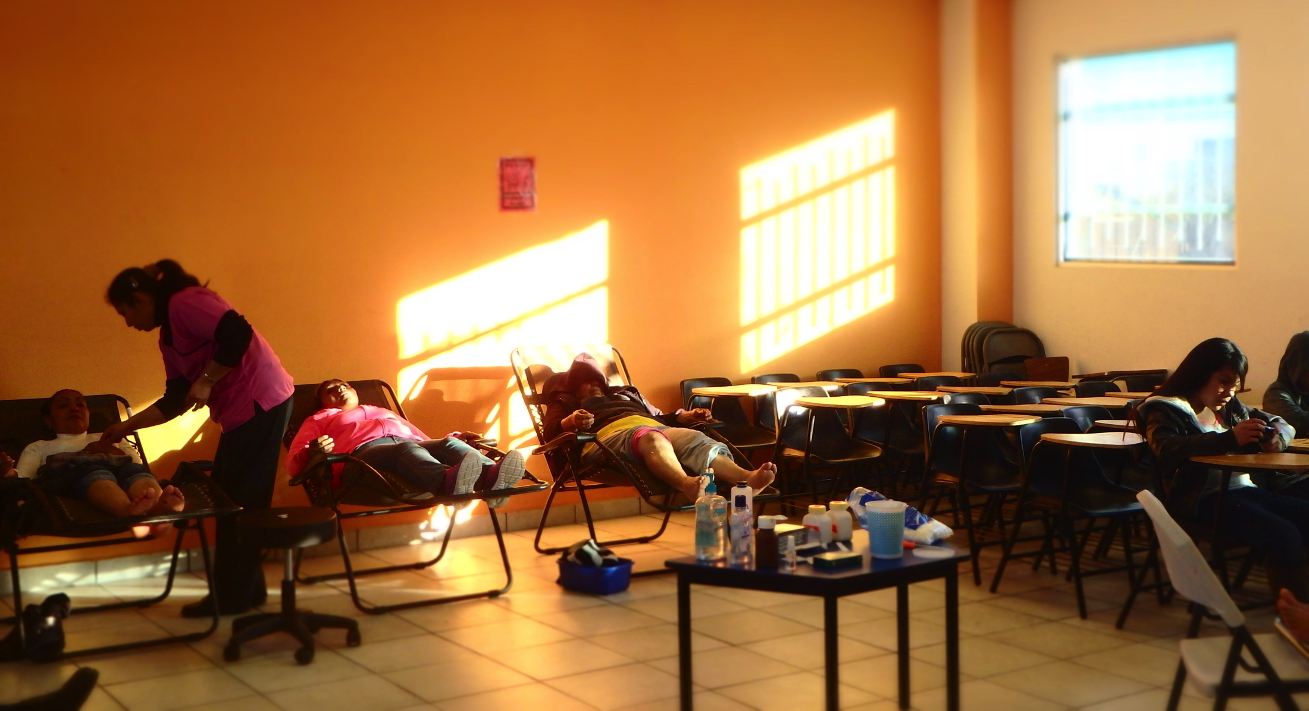
NADA integrated into community acupuncture dispensaries in churches

Slide 14
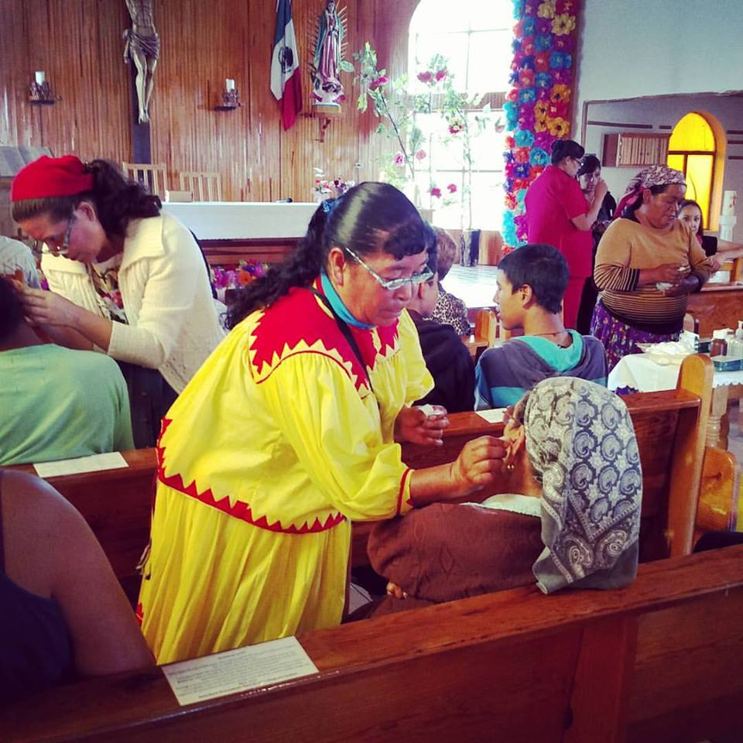
Nada offered after mass
Students from the Raramuri tribe, and nuns from local parishes in Copper Canyon, Mexico

Slide 15
Challenges of Outside Aid and the Strengths of the NADA Model for humanitarian aid
Challenges with Outside Aid Projects | Specific Problems presented | Strengths of the NADA Model
Cultural competency | Language barriers Outsiders doing the work Local systems, customs aren’t respected | NADA is non verbal Can be performed by local personnel Designed to function within local systems
Sustainability | Dependency on outside aid Contracting outside aid specialists is expensive | Needles are inexpensive Lay personnel can learn and apply safely and effectively Designed to empower local communities
Use of the Western Psych Model | Potential inappropriateness of DSM Diagnosis Drug therapy and talk therapy not always appropriate | NADA requires no diagnosis Ear acu is not a drug Designed to function as a brokering and complementary role within the western model

Slide 16
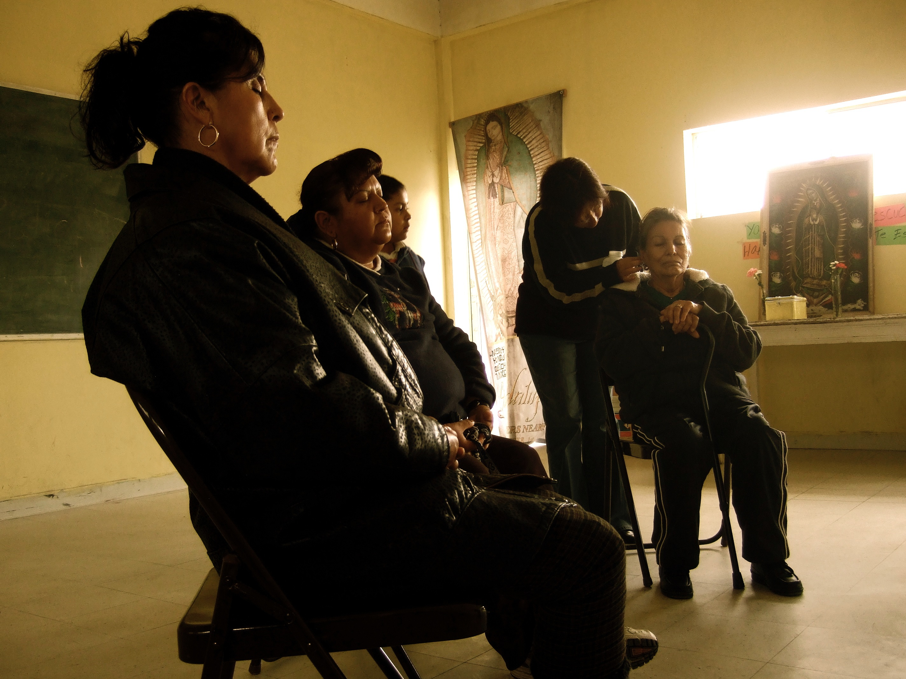
How you can support
Volunteers and Donations needed
Crossroadsacupuncture.com
Crossroadsacu@gmail.com

